Slide 1
Good Morning
Name tag
Check-in

Slide 2
iClicker Question
How to improve R-squared in your regression model?
Include more relevant variables (i.e., those help predict Y)
Include more data points
Both A and B

Slide 3
iClicker Question
Is it possible to include a variable with more than 2 categories (i.e., class standing – freshman, sophomore, junior, senior?
Yes
No

Slide 4
iClicker Question
Is it possible to have categorial variables be the dependent variables?
Yes
No
Notes:
Logistic or probit regression

Slide 5




Chapter 18: Analysis and Interpretation Multiple Variables Simultaneously

Slide 6

Multiple Regression Implementation
R
Excel
Real Example
Notes:
Excel: softserve + online return (under regression)
Rcloud: discussion case + virtual career service example

Slide 7
Learning Objectives
Discuss why a researcher might conduct a multivariate analysis
Explain the purpose and importance of cross tabulation
Describe a technique for comparing groups on a continuous dependent variable
Explain the difference between an independent sample t-test for means and a paired sample t-test for means
Discuss the Pearson product-moment correlation coefficient
Describe a technique for examining the influence of one or more predictor variables on an outcome variable

Slide 8
Why Use Multivariate Analysis?
Multivariate analyses allow researchers a closer look at their data than is possible with univariate analyses

Slide 9
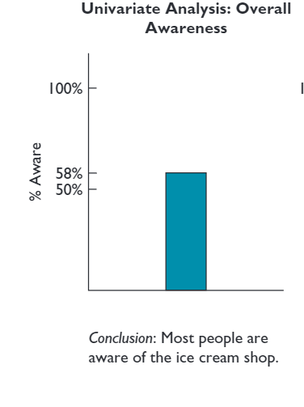
A Univariate Analysis Result

Slide 10
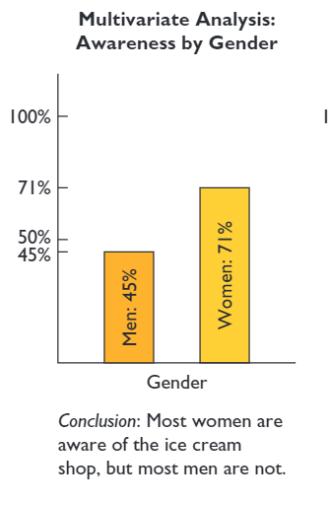
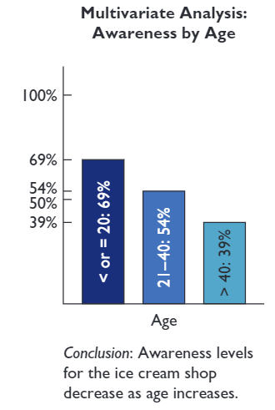
Multivariate Analysis Results: Enhanced Meaning

Slide 11
Cross Tabulation
A multivariate technique used for studying the relationship between two or more categorical variables. The technique considers the joint distribution of sample elements across variables

Slide 12
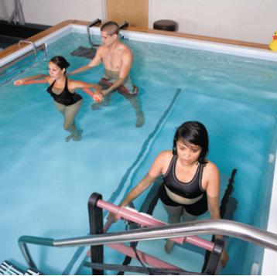
Back to the AFC Project
Question: Does being referred by a doctor to AFC lead to greater usage of the therapy pool?

Slide 13
Back to the AFC Project
Two Categorical variables:
Doctor referral (yes, no)
Pool Usage (yes, no)
In this situation,
Doctor referral would be considered the independent, or causal variable
Pool usage would be considered the dependent, or outcome variable.
This is an ideal situation for cross tabulation analysis

Slide 14
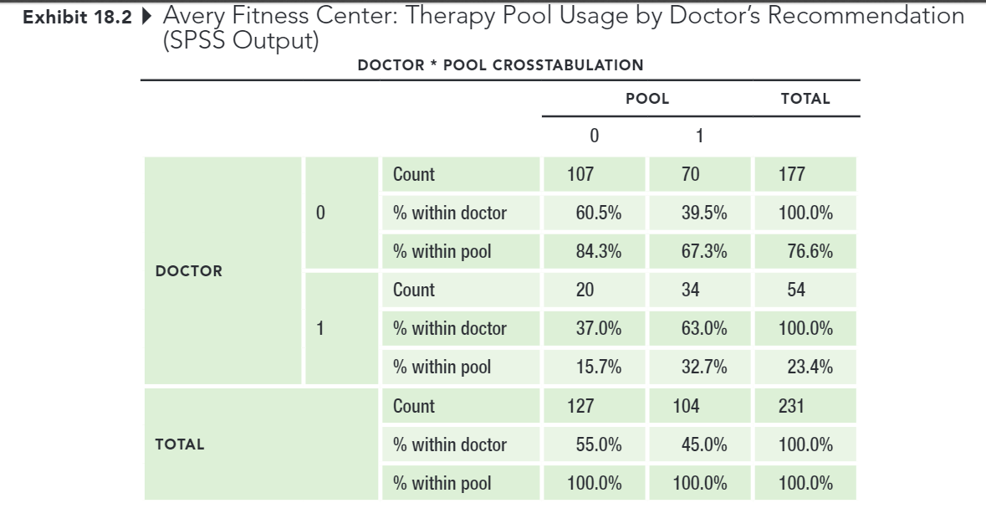
Back to the AFC Project
RAW SPSS OUTPUT

Slide 15
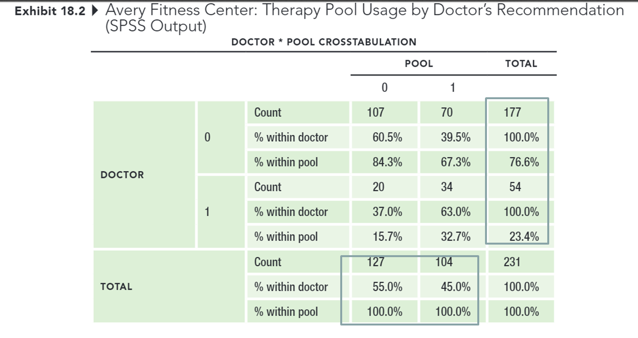
Back to the AFC Project
MARGINAL TOTALS

Slide 16
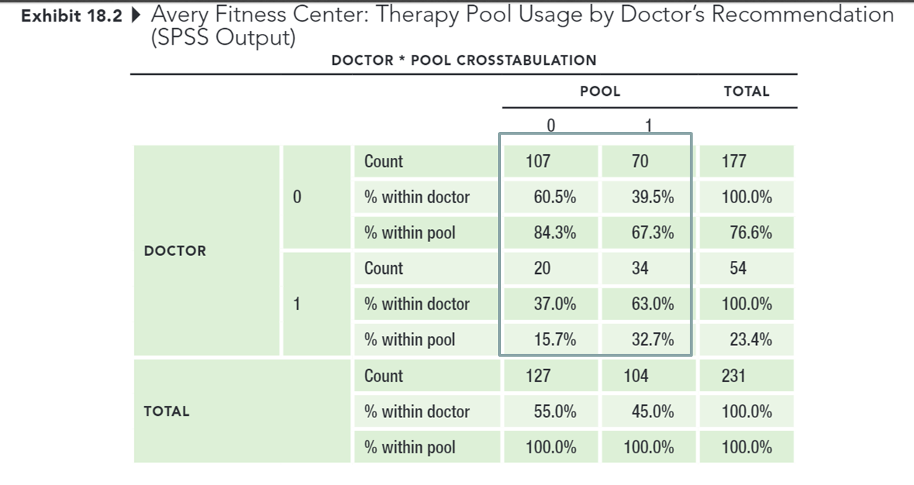
Back to the AFC Project
CELLS

Slide 17

Which Percentages Should I Use?
Always calculate percentages in the direction of the causal variable
Hint: Which variable might have caused the other to occur?

Slide 18
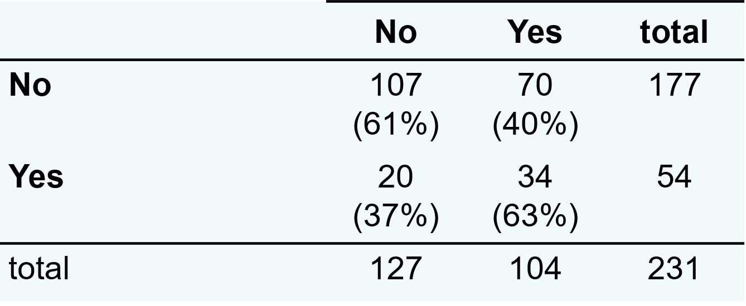
Presenting the Results
Doctor Recommendation?
Utilized Therapy Pool?

Slide 19
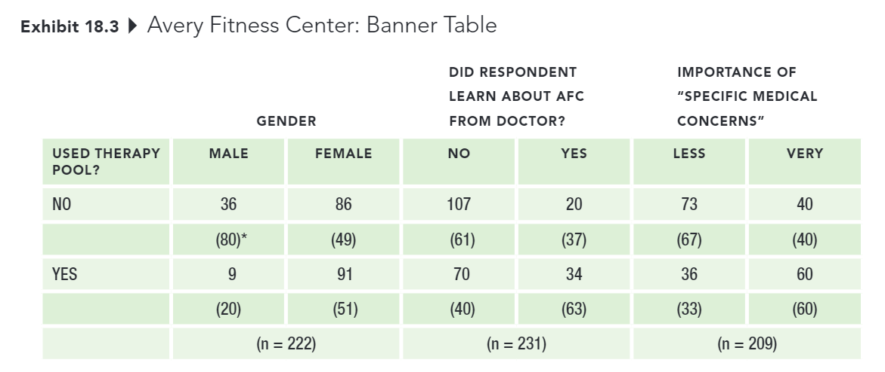
Presenting the Results
Banner: A series of cross tabulations between an outcome, or dependent variable, and serval (sometimes many) explanatory variables in a single table.

Slide 20

Cross-tabs: testing for Statistical Significance
Pearson Chi-square $χ^{2}$test of independence: A commonly used statistic for testing the null hypothesis that categorical variables are independent of one another.
Independent Sample t-test for means: A technique commonly used to determine whether two groups differ on some characteristic assessed on a continuous measure (e.g., satisfaction rating between men vs. women; age in years between customers vs. noncustomers)

Slide 21
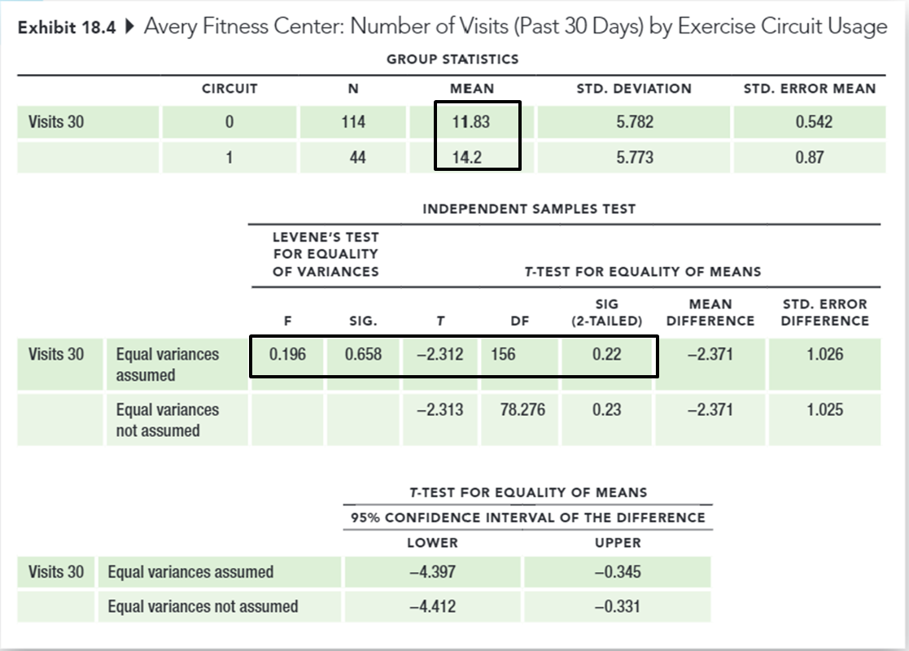
Cross-tabs: Testing for Statistical Significance
Does utilizing the exercise circuit (categorical independent variable) lead to increased number of visits to the center (continuous dependent variable)?

Slide 22
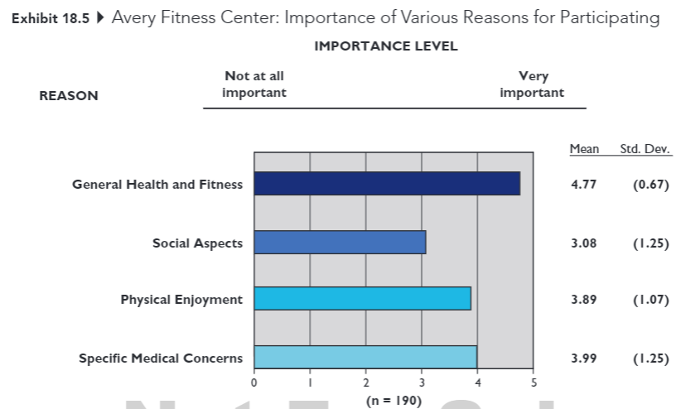
Cross-tabs: Testing for Statistical Significance
Paired Sample t-test: A technique for comparing two means when scores for both variables are provided by the same sample (e.g., before and after measures, applying same measure to different objects).

Slide 23
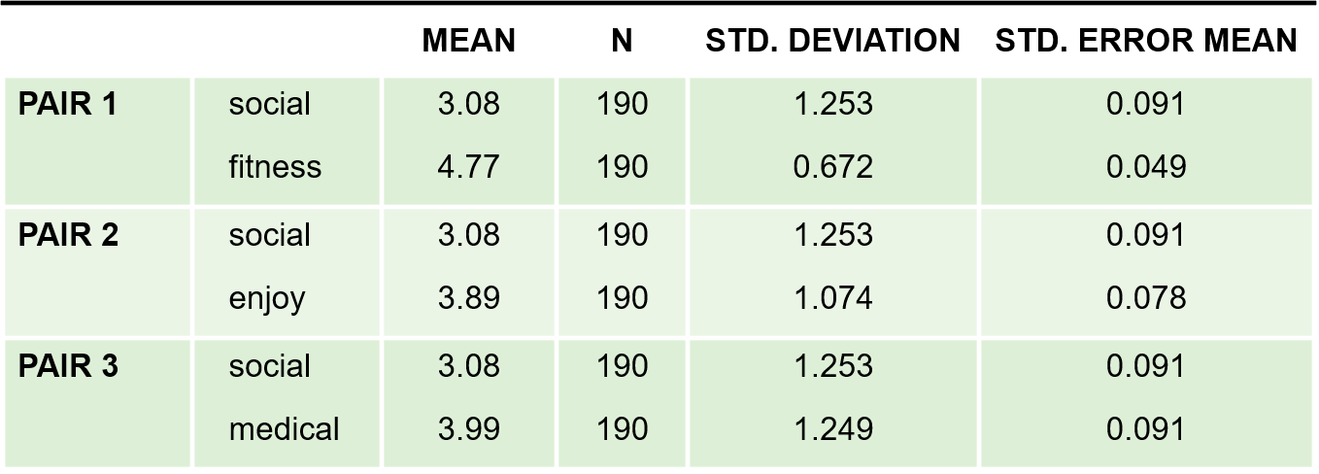
Cross-tabs: Testing for Statistical Significance
Exhibit 18.6 Avery Fitness Center: Paired Sample t-Tests (SPSS Output)
PAIRED SAMPLES STATISTICS
Do the mean attribute importance levels, provided by the same respondents, differ from one another?

Slide 24

Cross-tabs: Testing for Statistical Significance
Pearson product-moment correlation coefficient: A statistic that indicates the degree of linear association between two continuous variables. The correlation coefficient can range from -1 to +1

Slide 25
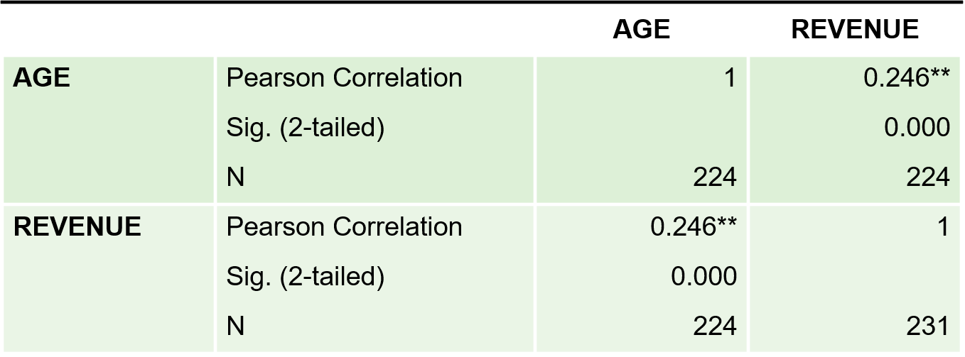
Cross-tabs: Testing for Statistical Significance
Exhibit 18.7 Avery Fitness Center: Correlation Between Age and Revenues (SPSS Output)
CORRELATIONS
Is there a correlation between age (continuous indent variable) and fees paid (continuous dependent variable)?

Slide 26
Cross-tabs: Testing for Statistical Significance
Ice cream purchases and murder rates are positively correlated
Notes:
Thankfully, correlation is not the same thing as causation.

Slide 27

Cross-tabs: Testing for Statistical Significance
Regression analysis: A statistical technique used to derive an equation representing the influence of a single (simple regression) or multiple (multiple regression) independent variables on a continuous dependent, or outcome variable

Slide 28
Cross-tabs: Testing for Statistical Significance
Question: What are some of the factors that drive revenues at AFC?
Regress revenues on
(1) member age and the importance of
(2) general health and fitness
(3) Social aspects
(4) Physical enjoyment
(5) Specific medical concerns as the reason for visiting AFC

Slide 29

Coefficient of Multiple Determination ($R^{2}$)
A measure representing the relative proportion of the total variation in the dependent variable that can be explained or accounted for by the fitted regression equation. When there is only one predictor viable, this value is referred to as the coefficient of determination.

Slide 30
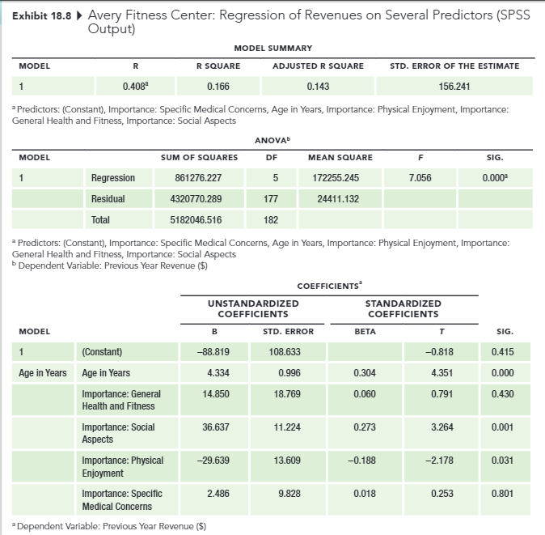
Coefficient of Multiple Determination

Slide 31
Key Steps in Interpreting Multiple Regression Results
Does the set of predictors explain a statistically significant portion of variation in the dependent variable? (look at the ANOVA table results)
1
How much of the variation in the dependent viable does our set of predictors explain?
2
Which of the individual predictors explain variation in the dependent variable, and what is the directions of the relationship (positive or negative)? (look at the t-values and p-values of the individual predictors)
3

Slide 32
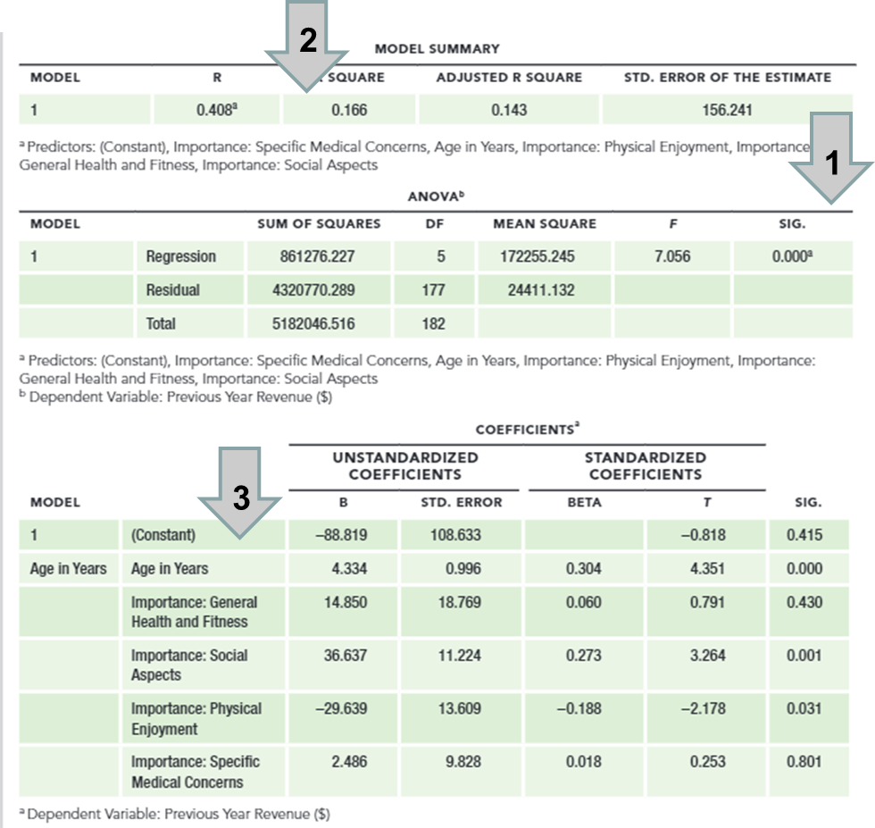
Key Steps in Interpreting Multiple Regression Results

Slide 33


Notes on Multiple Regression
Introduction to Multiple Regression
Real-world data are messy
Additional training: Marketing Analytics certificate
Notes:
These class sessions have given you an introduction to regression analysis and shown you a few of the ways it can be used by companies.
Actually conducting regression analysis requires additional training to avoid making analysis and interpretation errors.
Students who enjoyed the material on correlation and regression should consider getting a marketing analytics certificate. In that coursework, you’ll learn the technical details of running regression analysis plus many other ways data can be analyzed to help companies make marketing decisions.

Slide 34
Presentation Guidelines
Pointers on Presentation
Format: PowerPoint (recommended), Google Slides, Prezi
No back monitor (to resemble a business setting)
Slide tips
Sample Slides
Time: 15 minutes (under or over = 1 point deduction)
Q&A: 5 minutes
Grade is based on Presentation Evaluation Form
Notes:
Please remember that for the first 3 groups, I will be more lenient because they go first.
You don’t need suit and tie, but since this is a business presentation, hence professional dress is expected.
Remind:
Update about the order of presentation. I’ve checked with the syllabus, and the two dates are November 17th and 29th instead of November 29th and December 8th
I will work with groups that would like to change their date
In the last class, we didn’t go over the sample slides. Today we will cover it
Each team will have 20 mins
15 mins to present the project
5 mins for discussion and questions, evaluation
Sign-up Sheet
2 class sessions

Slide 35
Expected Slides
Background
Problem
Challenges
Selection & Sample Info
Important Research Questions
Recommendations (based on findings)
Limitations
Appendices
Research Objectives
Research Questions
Questionnaire

Slide 36
Presentation Critique
All groups that are not presenting need to submit a presentation critique for the presentation group (1 submission per group)
Assignment 10:
Presentation submission: 5 points
Instructor’s evaluation: 5 points
Peer’s evaluation: 10 points (it’s important to communicate your findings)
Presentation Evaluation Assignment
Notes:
Go over how to do presentation critique

Slide 37

Written Report
Questions regarding report?
Don’t confuse between presentation slides and written report
Notes:
Talk about the expected format of the report
You may wonder what the difference is between the presentation (if you use PowerPoint) and the written report. In the presentation, you have 10-12 minutes to present in the most succinct way about your research project, which means that you might not be able to address all the research questions. However, in the report, you can put everything that is of interest to the consumers of that report which is the managers in our case
If you attempt to submit the same PowerPoint presentation as your written report. You will receive no points for this assignment because you did not perform any work for this assignment.

Slide 38

15-min Group Discussion
Assignment 8: Initial Data Analysis
Assignment 9: if you want to talk (by midnight today)
Assignment 10: Presentation Guidelines
Assignment 11: Presentation Critique
Assignment 12: Written Report
Notes:
We are moving very fast. Hence, I strongly recommend you guys to divide and conquer early on. We technically we only 3 weeks left.

Slide 39

5-min snippet – Traffic Jam
Why does traffic jam happen?
Notes:
http://www.netlogoweb.org/launch#http://www.netlogoweb.org/assets/modelslib/Sample%20Models/Social%20Science/Traffic%202%20Lanes.nlogo
I bet all of us here have all been in traffic jams before. We usually think that there might be some accidents or a chicken cross the road ahead. But interestingly, most of the time, there nothing happen or the accident or the deer is long gone but the congestion can last hours.
Why does this phenomenon happen?
This model demonstrates how traffic jams can form. In the two-lane version, drivers can change lanes
The SPEED-UP slider controls the rate at which cars accelerate when there are no cars ahead.
The SLOW-DOWN slider controls the rate at which cars decelerate when there is a car close ahead.
The MAX-PATIENCE slider controls how many times a car can slow down before a driver loses their patience and tries to change lanes. Each time the driver has to hit the brakes to avoid hitting the car in front of them, they loose a little patience. When a driver’s patience expires, the driver tries to change lane. The driver’s patience gets reset to the maximum patience.
What do you think if drivers have less patience (likely to change lane)? What happen to the average speed?
Traffic jams can start from small “seeds.” Cars start with random positions. If some cars are clustered together, they will move slowly, causing cars behind them to slow down, and a traffic jam forms.
Even though all of the cars are moving forward, the traffic jams tend to move backwards. This behavior is common in wave phenomena: the behavior of the group is often very different from the behavior of the individuals that make up the group.
When the number of cars in the model is high, drivers lose their patience quickly and start weaving in and out of lanes. This phenomenon is called “snaking” and is common in congested highways. And if the number of cars is high enough, almost every car ends up trying to change lanes and the traffic slows to a crawl, making the situation even worse, with cars getting momentarily stuck between lanes because they are unable to change. Does that look like a real life situation to you?
Watch the MEAN-SPEED monitor, which computes the average speed of the cars. What happens to the speed over time? What is the relation between the speed of the cars and the presence (or absence) of traffic jams?
Look at the two plots. Can you detect discernible patterns in the plots?

